Slide 1
标题：应用管理容器化 – The Kubernetes
Charles Cai
2019年1月22日

Slide 2
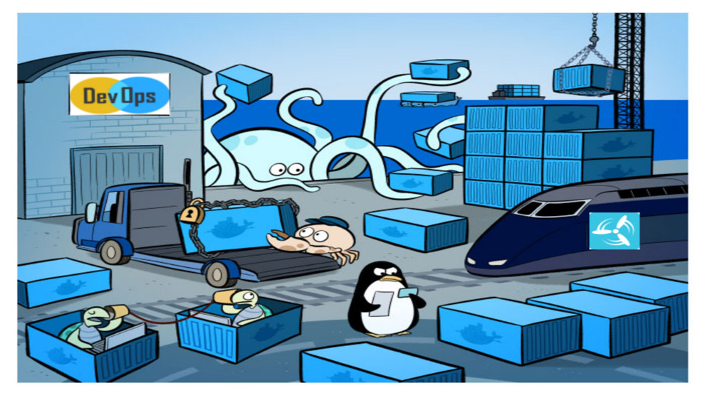
1. What is Kubernetes?
A orchestration system - automates deployment, scale and manage containers
A infrastructure – container-centric,
deploy workloads on distributed
systems
Has abbreviation – k8s

Slide 3
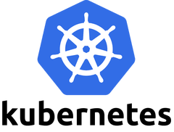
2. Kubernetes Feature & Character
Features & Characters:
Apps can be deployed quickly and predictably
Apps can be scaled on the fly
Roll out new feature seamlessly
Hardware resource can be utilized optimally
Extensible – modularized, pluggable
Self-healing – auto-scaling, auto-restart etc

Slide 4
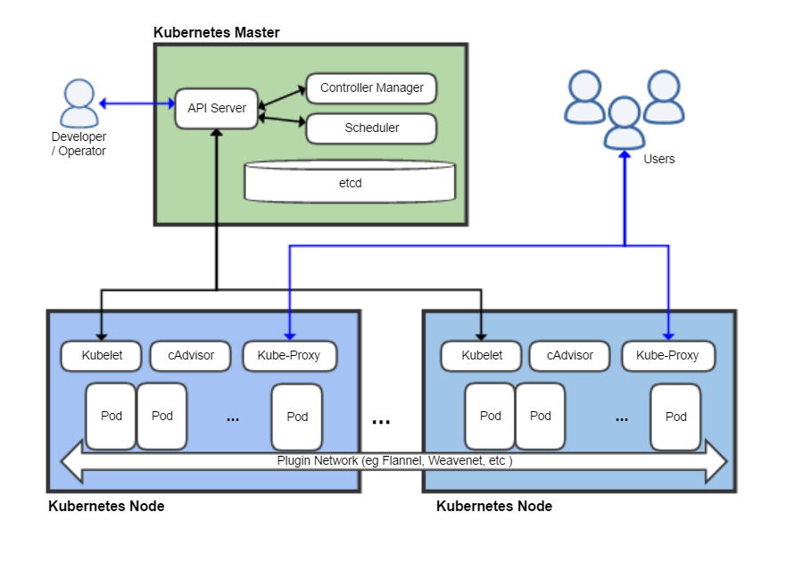
3. Kubernetes Architecture

Slide 5
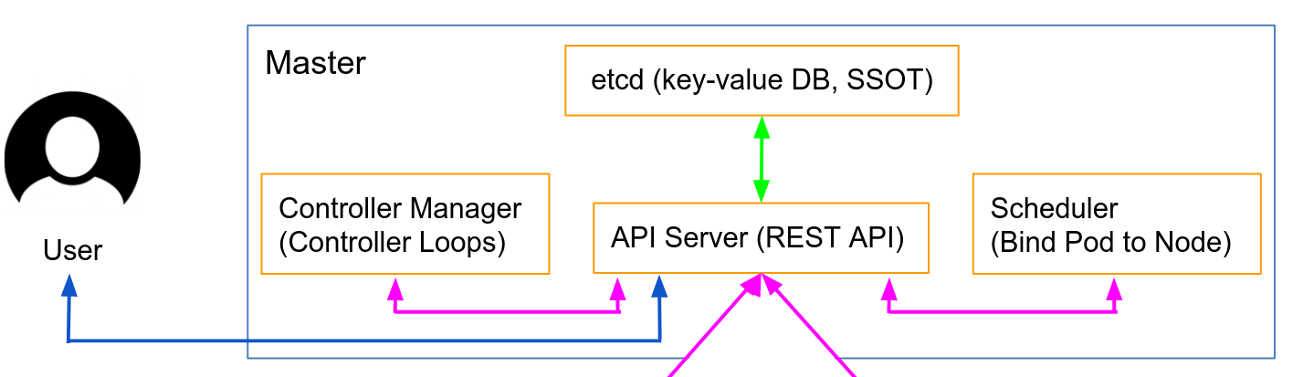
4. Master Component
Processes:
kube-apiserver – process REST operations
kube-controller-manager – All other cluster-level functions
kube-scheduler – binds unscheduled pods to nodes
Brain:
etcd – store configuration data

Slide 6
5. Kubernetes (k8s) Objects
Basic:
Pods – the smallest deployable object in k8s
Service – an abstraction which defines a logical set of Pods
Volume - an directory which is accessible to Pods
:
:
Controller:
Deployment – manage Pods and ReplicaSets
DaemonSet - run a Pod on all or some Nodes
Job – run one time jobs on Kubernetes
:
:

Slide 7
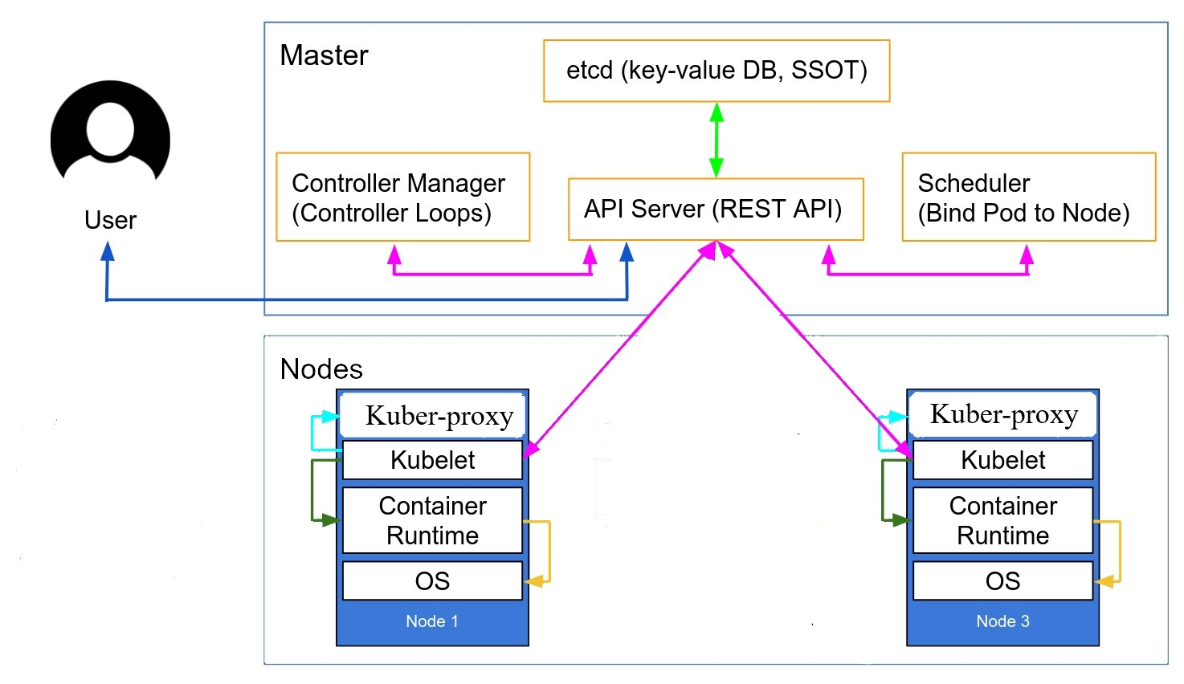
6. Node Component
kubelet – an agent that runs on each node
kube-proxy – configures and maintains network configuration and perform net-forwarding

Slide 8
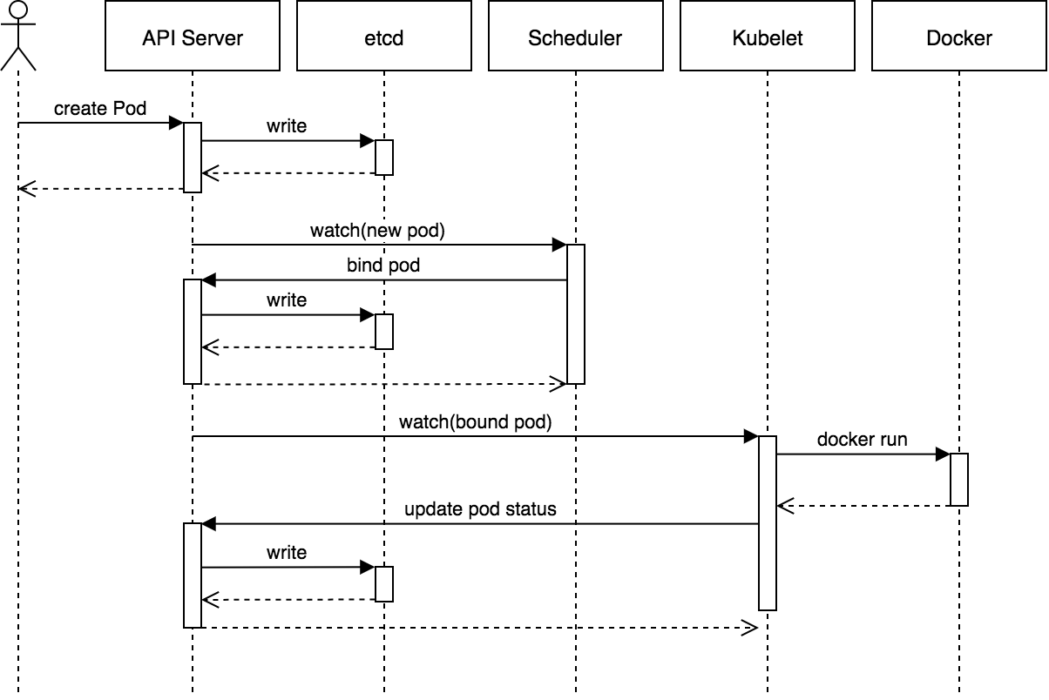
7. Kubernetes Recap

Slide 9
8. Future Prospects
Concerns:
1. steep learning curves
2. lengthy setup and error-prone
--------------------------------------------------------------------
Long term goal:
setup production grade k8s system
create full-automated dev k8s environment
create a web-based, API-driven deployment system, from setup k8s system to app deployment to k8s

